Slide 1





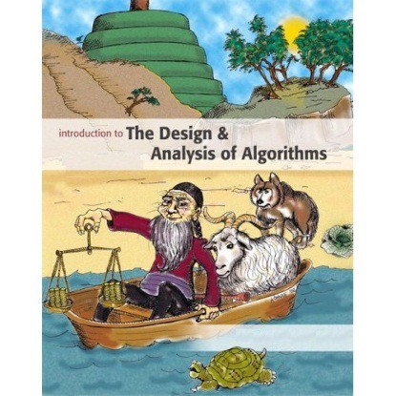



Introduction to
Algorithm Design and Analysis
[3] Recursion
Yu Huang
http://cs.nju.edu.cn/yuhuang Institute of Computer Software Nanjing University

Slide 2

In the Last Class …
Asymptotic growth rate
o Ο, Ω, Θ
o o, ω
Brute force algorithms
By iteration
By recursion

Slide 3

Recursion
Recursion in Algorithm Design
The divide and conquer strategy
Proving the correctness of recursive procedures
Solving recurrence equations
Some elementary techniques
Master theorem

Slide 4



Recursion in Algorithm Design
Computing n! with Fac(n)
o if n=1 then return 1 else return Fac(n-1)*n
M(1)=0 and M(n)=M(n-1)+1 for n>0 (critical operation: multiplication)
Hanoi Tower
o if n=1 then move d(1) to peg3 else
Hanoi(n-1, peg1, peg2); move d(n) to peg3; Hanoi(n-1, peg2, peg3)
M(1)=1 and M(n)=2M(n-1)+1 for n>1 (critical operation: move)

Slide 5

Recursion in Algorithm Design
Counting the Number of Bits
Input: a positive decimal integer n
Output: the number of binary digits in n’s binary representation
Int BitCounting (int n)
⎧0
n = 1
⎩T (⎣n / 2⎦)+1 n > 1
If(n==1) return 1;
Else
return BitCounting(n div 2) +1;
T (n) = ⎨

Slide 6

Divide and Conquer
Divide
Divide the “big” problem to smaller ones
Conquer
Solve the “small” problems by recursion
Combine
Combine results of small problems, and solve the original problem

Slide 7




Divide and Conquer
The general pattern solve(I)
n=size(I);
if (n≤smallSize) solution=directlySolve(I)
else
divide I into I₁,… I_{k}; for each i∈{1,…,k}
S_{i}=solve(I_{i});
solution=combine(S₁ ,… ,S_{k}); return solution
T(n)=B(n) for n≤smallSize
k
T(n)=D(n)+∑T(size(I_{i}))+C(n)
i =1
for n>smallSize

Slide 8

Examples
Max sum subsequence
𝑛𝑛
2
𝑇𝑇 𝑛𝑛
= 2𝑇𝑇
+ 𝑛𝑛
Part 1
Part 2
the sub with largest sum may be in:
recursion
Part 1
Part 2
or:
The largest is the result
Part 1
Part 2

Slide 9

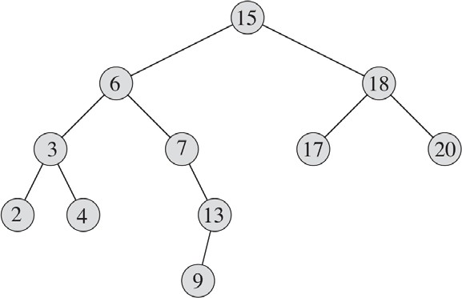
Examples
Arrays
Trees

Slide 10



Workhorse
“Hard division, easy combination”
“Easy division, hard combination”
Usually, the “real work” is in one part.

Slide 11






Correctness of Recursion
Recursion
…
Case n=k+1 Case n=k
… Case n=2
Base case
n=1
Induction

Slide 12



Analysis of Recursion
Solving recurrence equations
E.g., Bit counting
Critical operation: add
The recurrence relation
n = 1
⎨T (⎣n / 2⎦)+1 n > 1
T (n) = ^{⎧0}
⎩

Slide 13

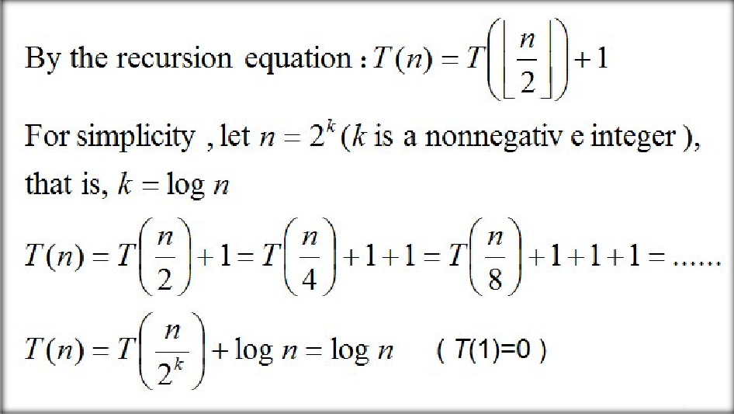
Analysis of Recursion
Backward substitutions

Slide 14

Smooth Functions
f(n)
Nonnegative eventually non-decreasing function defined on the set of natural numbers
f(n) is called smooth
o If f(2n)∈Θ(f(n)).
Examples of smooth functions
o logn, n, nlogn and n^{α} (α≥0)
E.g., 2nlog2n = 2n(logn+log2)∈Θ(nlogn)

Slide 15

Even Smoother
Let f(n) be a smooth function, then, for any fixed integer b≥2, f(bn)∈Θ(f(n)).
o That is, there exist positive constants c_{b} and d_{b} and a nonnegative integer n₀ such that
d_{b}f(n) ≤ f(bn) ≤ c_{b}f(n) for n≥n₀.
It is easy to prove that the result holds for b = 2^{k} , for the second inequality :
f ( 2^{k} n ) ≤ c^{k} f ( n ) for k = 1,2,3... and n ≥ n .
2 0
For an arbitrary integer b ≥ 2, 2^{k-1} ≤ b ≤ 2^{k}
Then, f ( bn ) ≤ f ( 2^{k} n ) ≤ c^{k} f ( n ), we can use c^{k} as c .
2 2 b

Slide 16

Smoothness Rule
Let T(n) be an eventually non-decreasing function and f(n) be a smooth function.
o If T(n)∈Θ(f(n)) for values of n that are powers of
b(b≥2), then T(n)∈Θ(f(n)).
Just proving the big - Oh part :
By the hypothsis : T( b^{k} ) ≤ cf ( b^{k} ) for b^{k} ≥ n .
0
By the prior result : f ( bn ) ≤ c_{b} f ( n ) for n ≥ n₀ .
Let n ≤ b^{k} ≤ n ≤ b^{k +1} ,
0
T( n ) ≤ T( b^{k +1} ) ≤ cf ( b^{k +1} ) = cf ( bb^{k} ) ≤ cc f ( b^{k} ) ≤ cc f ( n )
b b
Non-decreasing
hypothesis
Prior result
Non-decreasing

Slide 17






Computing the Fibonacci Number
f₁=0
f₂=1
^{f}n^{= f}n-1^{+ f}n-2
0, 1, 1, 2, 3, 5, 8, 13, 21, 34, ......
a_{n} = r₁ a_{n 1} + r₂a_{n 2} +☹+ r_{m} a_{n k}
is called linear homogeneous relation of degree k.
For the special case of Fibonacci: a_{n}=a_{n-1}+a_{n-2}, r₁=r₂=1

Slide 18

Characteristic Equation
For a linear homogeneous recurrence relation of degree
k
a = r a + r a +☹+ r a
n 1 n−1 2 n−2
k n−k
the polynomial of degree k
k k−1
k−2
x = r x
+ r x +☹+ r
1 2
k
is called its characteristic equation.
The characteristic equation of linear homogeneous recurrence relation of degree 2 is:
x² − r x − r = 0
1 2

Slide 19





Solution of Recurrence Relation
2
= 0 of the
has two distinct
If the characteristic equation x − r x − r
1 2
recurrence relation roots s₁ and s₂, then
ªn ^{= r}1ªn−1 ^{+ r}2ªn−2
a = us^{n} + vs^{n} n 1 2
where u and v depend on the initial conditions, is the explicit formula for the sequence.
If the equation has a single root s, then, both s₁ and s₂ in the formula above are replaced by s

Slide 20

Proof of the Solution
Remember equation : x²
r x r = 0
1 2
We need prove that : us^{n} + vs^{n} = r a + r a
1 2 1 n 1 2 n 2
us^{n} + vs^{n} = us^{n 2} s² + vs^{n 2} s² 1 2 1 1 2 2
= us^{n 2} ( r s + r ) + vs^{n 2} ( r s + r )
1 1 1 2 2 1 2 2
= rus^{n 1} + r us^{n 2} + r vs^{n 1} + r vs^{n 2} 1 1 2 1 1 2 2 2
= r ( us^{n 1} + vs^{n 1} ) + r ( us^{n 2} + vs^{n 2} )
1 1 2 2 1 2
= r₁a_{n 1} + r₂a_{n 2}

Slide 21






Back to Fibonacci Sequence
f₁=1
f₂=1
^{f}n^{= f}n-1^{+ f}n-2
0, 1, 1, 2, 3, 5, 8, 13, 21, 34, ......
Explicit formula for Fibonacci Sequence
The characteristic equation is x²-x-1=0, which has roots:
5 5
s = ¹⁺
and s = ¹⁻
1
2
2 2
Note: (by initial conditions) f₁ = us₁ + vs₂ =1 and
f = us ² + vs ² =1
2 1 2
which results:
_{5 ⎞}n _{5 ⎞}n
_{f =} 1 ⎛ 1 +
1 ⎛ 1 −

5 ⎝ 2
 − 
⎠ ⁵ ⎝

⎠
n
2

Slide 22


Guess and Prove
Example: T(n)=2T(⎣n/2⎦) +n
Guess
T(n)∈O(n)?
T(n)≤cn, to be pr
o T(n)∈O(n²)?
Try to prove T(n)≤cn:
T(n)=2T(n/2)+n ≤ 2c(n/2)+n
≤ 2c(n/2)+n = (c+1)n, Fail!
d for c large enough
However:
oved for c large enough
T(
T(n) = 2T(⎣n/2⎦)+n
n) = 2T(n/2)+n ≥ 2cn/2+n
≥ 2c[(n-1)/2]+n = cn+(n-c) ≥ cn
ogn)?
d for c large enough
T(n)≤cn², to be prove
o Or maybe, T(n)∈O(nl
≤ 2(c⎣n/2⎦ log (⎣n/2⎦))+n
≤ cnlog (n/2)+n
= cn log n – cn log 2 +n
= cn log n – cn + n
≤ cn log n for c≥1
T(n)≤cnlogn, to be prove
Prove
o by substitution

Slide 23






Divide and Conquer Recursions
Divide and conquer
Divide the “big” problem to smaller ones
Solve the “small” problems by recursion
Combine results of small problems, and solve the original problem
Divide and conquer recursion
T(n) = b T(n/c) + f(n)
divide
combine
conquer

Slide 24

Recursion Tree
T(size)
nonrecursive cost
T(n)
n
T(n/2)
n/2
T(n/2)
n/2
T(n/4)
n/4
T(n/4)
n/4
T(n/4)
n/4
T(n/4)
n/4
The recursion tree for T(n) = 2T(n/2) + n

Slide 25
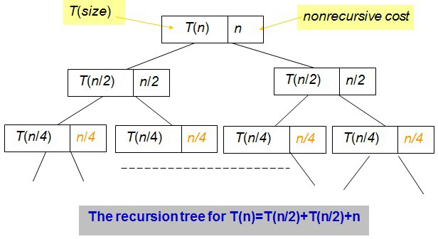
Recursion Tree
Node
Non-leaf
Non-recursive cost
Recursive cost
Leaf
Base case
Edge
Recursion

Slide 26





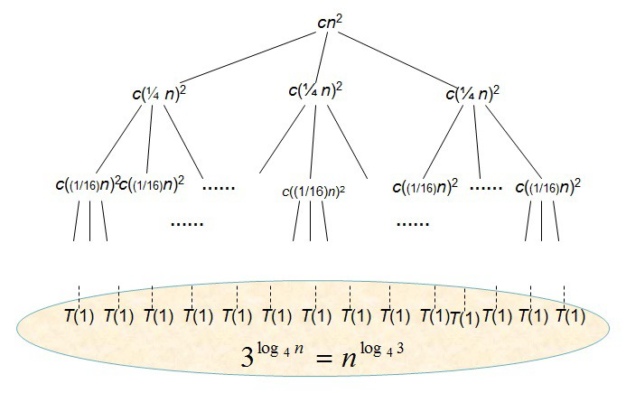

Recursion Tree
Recursive cost
Non-recursive cost
T(n) = 3T(n/4) + Θ (n²)
# of sub-problems
size of sub-problems
Total cost
𝜮𝜮
Sum of row sums

Slide 27




Sum of Row-sums
T(n)=3T(⎣n/4⎦)+Θ(n²)
cn²
cn²
3 _{cn2}
16
c(¼ n)²
c(¼ n)²
c(¼ n)²
log₄n
c((1/16)n)² c((1/16)n)² ……
c((1/16)n)²
……
c((1/16)n)²
2
^{⎛ 3 ⎞} cn²
c((1/16)n)²
⎜ ₁₆ ⎟
⎝ ⎠
……
……
…
_{Θ(n}log₄ 3 ₎
T(1) T(1) T(1) T(1) T(1) T(1) T(1) T(1) T(1) T(1)T(1) T(1) T(1) T(1)
_{= n}log₄ 3
Note:3^{log4 n}
Total: Θ(n²)

Slide 28





Solving the Divide-and- Conquer Recurrence
The recursion equation for divide-and- conquer, the general case: T(n)=bT(n/c)+f(n)
Observations:
Let base-cases occur at depth D(leaf), then n/c^{D}=1, that is
D=log(n)/log(c)
Let the number of leaves of the tree be L, then L=b^{D}, that _{is L=b}(log(n)/log(c)).
By a little algebra: L=n^{E}, where E=log(b)/log(c), called
critical exponent.

Slide 29


Recursion Tree for
T(n)=bT(n/c)+f(n)
f(n)
f(n)
b
f(n/c)
b
f(n/c)
f(n/c)
bf (n / c)
log_{c}n
f(n/c²)
f(n/c²)
f(n/c²)
f(n/c²)
f(n/c²)
f(n/c²)
f(n/c²)
……
f(n/c²)
f(n/c²)
b² f (n / c² )
……
…
_{Θ(n}log_{c} b ₎
T(1) T(1) T(1) T(1) T(1) T(1) T(1) T(1) T(1) T(1) … T(1) T(1) T(1)
_{= n}log_{c} b
Note: b^{logc n}
Total ?

Slide 30



Divide-and-Conquer - the Solution
The solution of divide-and-conquer equation is the non-recursive costs of all nodes in the tree, which is the sum of the row-sums
o The recursion tree has depth D=log(n)/ log(c), so there are about that many row-sums.
The 0th row-sum
o is f(n), the nonrecursive cost of the root.
The Dth row-sum
o is n^{E}, assuming base cases cost 1, or Θ(n^{E}) in any event.

Slide 31




Solution by Row-sums
[Little Master Theorem] Row-sums decide the solution of the equation for divide-and- conquer:
Increasing geometric series: T(n)∈Θ(n^{E})
Constant: T(n)∈Θ (f(n) log n)
Decreasing geometric series: T(n)∈Θ (f(n))
This can be generalized to get a result not using explicitly row-sums.

Slide 32



Master Theorem
Loosening the restrictions on f(n)
o Case 1: f(n)∈O(n^{E-ε}), (ε>0), then:
T(n)∈Θ(n^{E})
o Case 2: f(n)∈Θ(n^{E}), as all node depth contribute about equally:
T(n)∈Θ(f(n)log(n))
o case 3: f(n)∈Ω(n^{E+ε}), (ε>0), and if 𝑏𝑏𝑏𝑏(𝑛𝑛/𝑐𝑐) ≤ 𝜃𝜃𝑏𝑏(𝑛𝑛) for some constant 𝜃𝜃 < 1 and all sufficiently large n, then:
T(n)∈Θ(f(n))
The positive ε is critical, resulting gaps between cases as well

Slide 33
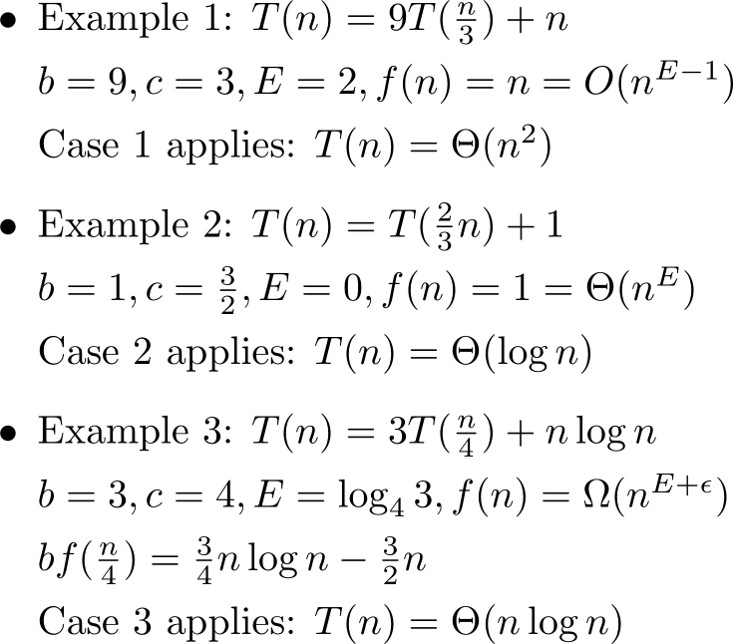
Using Master Theorem

Slide 34



Looking at the Gap
Often, none of the 3 cases in the Master Theorem apply.
Your task: Design such a recursion

Slide 35




Thank you!
Q & A
Yu Huang yuhuang@nju.edu.cn http://cs.nju.edu.cn/yuhuang

